Slide 1

Object-Oriented Design and UML Basics
Svetlin Nakov
Telerik Corporation
www.telerik.com

Slide 2

Table of Contents
Part I: Activities in Software Development
Part II: Introduction in Object Oriented Design
Part III: Introduction in UML

Slide 3

Activities in Software Development

Slide 4

Software Development
Software development includes few basic activities:
Analyze requirements
Design
Implementation
Теsting

Slide 5

Requirements
Software requirements
Answer the question “What”?, not “How”?
Functional and not functional requirements
Start with a vision
Step by step requirements are detailed and clarified

Slide 6
Requirements (2)
It is hard to define requirements fully and precisely
Well defined requirements save time and money during the entire project
Requirements are always changing during the process of development
Good specification minimize future changes

Slide 7
Design
Software design describes how the system will fulfill the requirements
Architecture design describes:
How the project will be decomposed in to pieces (modules)
Responsibility of each module
Interconnection between the modules
Interfaces for communication

Slide 8
Design (2)
Detailed design
Describes the internal structure and organization of each module
Object-oriented design
Describe which classes and objects are needed, their responsibilities and interconnections
Inner classes design
Describes how classes work
Methods responsibilities and used algorithms

Slide 9
Implementation
Implementation
The process of writing the source code
The code strictly follows the design
Inexperienced developers think that, writing code is the only software development activity
Most of important decisions are often taken when analyzing the requirements or during the design process

Slide 10
Testing and Debugging
Testing checks if the implemented project fulfills the requirements
Purpose of testing is to find defects (errors)
Black-box and white-box tests – performed by testers
Unit tests – written by developers
System tests – performed by testers
Debugging finds the cause of given defect and fixes it

Slide 11

Introduction to Object- Oriented Design

Slide 12

Introduction to Object- Oriented Design
Contents:
What is Object-Oriented design?
Identification of Classes
Class Characteristics
Definition of Responsibilities
Cohesion and Coupling

Slide 13

Object-Oriented Design (OOD)
OOD is the process of modeling system with classes from OOP
Decomposing the requirements
Modeling the requirements
Class identification
Attributes
Operations
Defining relationships between the classes

Slide 14

Object-Oriented design (2)
The tool of OOP design: Unified Modeling Language (UML)
Behavior diagrams
Use-case diagrams
Sequence diagrams
Activity diagrams
Structure diagrams
Class diagrams
Deployment diagrams

Slide 15
Identification of Classes and Their Characteristics
The main purpose of OOP design is to identify classes and objects in the system
Potential classes and entities from the real world, described in requirements
Nouns from specification are candidates for classes or characteristics of classes
Verbs from specification are candidates for operations in the classes

Slide 16
Identification of Classes and Their Characteristics (2)
Extract from the specification of a project:
Not all of nouns correspond to a class or attribute in the system !!!
The user must be allowed to specify each product by its primary characteristics, including its name and product number. If the bar code does not match the product, then an error should be generated to the message window and entered into the error log. The summary report of all transactions must be structured as specified in section 7.A.

Slide 17
Classes and Objects
Classes present a set of objects with the same structure
Characteristics
Behavior
Class names should be singular nouns, coming from the real-world problem
Example: Student, Message, Account
We can create many instances of any class
E.g. savings is object of class Account

Slide 18
Class Identification
Sometimes is hard to decide how the real-world entities should be modeled
For example address could be class Address or a just a text field
The better you research the problem, the better decision you will be able to take
When given class is too big and complicated, it should be decomposed in several smaller classes

Slide 19
Class Characteristics
Classes which represent the objects from the real world, have attributes (characteristics)
Example: class Student has a name, school and list of courses
Not all of characteristics are important for the software system
Example: for the class Student color of the eyes is not important characteristic
Only important characteristics should be modeled

Slide 20
Class Responsibilities
Each class should have clear defined responsibilities
Which objects or process from the real world represents?
Which tasks does it perform?
Every action in the program is made by one or several methods, or by one or several classes
Actions are modeled by operations (methods)

Slide 21
Class Responsibilities (2)
For the names of methods are used verb + noun
Example: PrintReport(), ConnectToDatabase()
Often is impossible to define at the moment all of methods for a given class
Define first most important methods–those which realize main responsibilities of the class
Needed of additional methods later

Slide 22
Cohesion and Coupling
Fundamental principals in software design (OOP design also)
Strong cohesion
Classes have single purpose
Class solves one clearly defined task ( only one !)
Loose coupling
Weak interconnection with the other classes

Slide 23

Introduction to UML

Slide 24

Introduction in UML
Contents:
What is modeling?
What is UML?
Use case diagrams
Class diagrams
Sequence diagrams
Activity diagrams

Slide 25
What is Modeling?
Modeling means to create abstraction of reality
Abstraction are simple image of reality
They ignore minor details
Save only important details
What is important and what is not, depends on purpose of a model

Slide 26
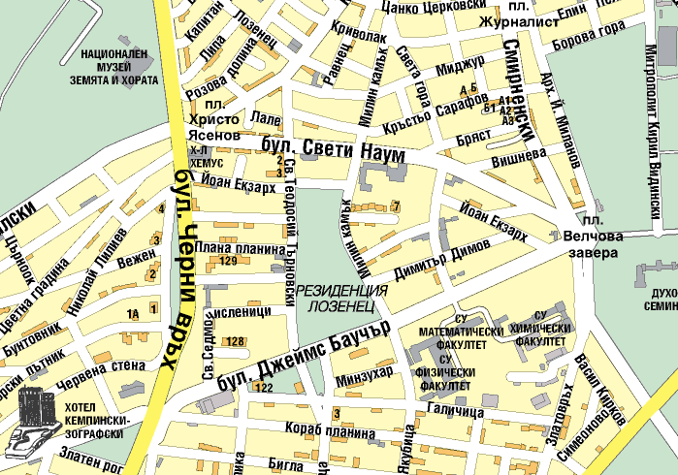
Example: City Map

Slide 27
Software Modeling- Why is Needed?
Software difficulty permanently increase
Windows XP is more than 40 million lines of source code
Developer could never understand such a source in details
There is a need of simple description of complicated systems
Modeling is a tool for fixing complexity

Slide 28
Systems, Models and Views
Model
Abstraction which describes subset of a system
View
Describes chosen aspects from a model
Notations
Sets of graphic and text rules for representing the views
Views and models of given system can cover each other

Slide 29
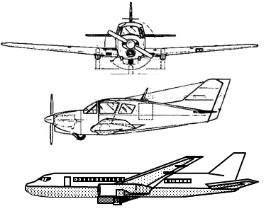
Systems, Models and Views (2)
Example
System: airplane
Models:
Flight simulator
Aerodynamic model
View
Electric system
Engine system
heating system

Slide 30
Systems, Models and Views (3)
Flight simulator
Heating
system
Airplane
Electric wiring
Aerodynamic
model

Slide 31
Models, Views and Systems (UML)
System
*
Model
*
View
Represents by
Represents with
Airplane: System
Scale Model: Model
Flight Simulator: Model
Blueprints: View
Fuel System: View
Electrical Wiring: View

Slide 32
What is UML?
UML (Unified Modeling Language)
International standard for software systems modeling
Universal notation for graphic representation of a model
Supported by a lot of tools
Together
Rational Rose
Microsoft Visio
Poseidon

Slide 33
UML: Types of Diagrams
Use case diagrams:
Describes behavior of a system from an user viewpoint
What can do different types of users
Class diagrams
Describe classes (attributes and methods) and bonds between them (associations, inheritance)

Slide 34
UML: Types of Diagrams (2)
Sequence diagrams
Schematic description of a relationship between users and the system
Individual actions are sorted in time
State chart diagrams
Describe possible states of given process and possible transitions between them

Slide 35
UML: Type of Diagrams (3)
Activity diagrams
Describes the flow of the working process (workflow)
Look like something like block-schemes

Slide 36

Use Case Diagrams

Slide 37
UML: Use Case diagrams
Airplane: System
Package
Use case
Watch
Actor
ReadTime
WatchUser
SetTime
WatchRepairPerson
ChangeBattery

Slide 38

Actors
Actor is someone who interact with the system
user
External system
External environment
Actor has unique name and eventual description
Example:
Passenger: a man in train
GPS satellite: provide GPS coordinates
Passenger
GPS
satellite

Slide 39
Use Case
One use case describes one functionality of the system
It consists of :
Unique name
Connected with actors
There are entry conditions
Contains a stream of actions
There are output conditions
There may be other requirements
Purchase
ticket
View the
timetable

Slide 40
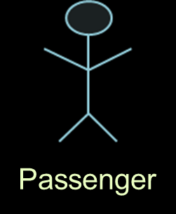
Relation <<extends>>
<<extends>> presents rare exception or emergent event
The process for handling an exceptional situation is beyond the basic use case
PurchaseTicket
<<extends>>
<<extends>>
<<extends>>
OutOfOrder
<<extends>>
TimeOut
Cancel
NoChange

Slide 41
Relation <<includes>>
<<includes>> is a behavior which is taken outside of use case
Allows reuse of shared functionality
Passenger
PurchaseMultiCard
PurchaseSingleTicket
<<includes>>
<<includes>>
CollectMoney
<<extends>>
<<extends>>
NoChange
Cancel

Slide 42

Class diagrams

Slide 43
UML: Class diagrams
Association
Class
Multiplicity
Watch
1
2
2
2
2
PushButton
LCDDisplay
Battery
Time
state
blinkldx
load
now
push() release()
blinkSeconds()
blinkMinites()
blinkHours()
stopBlinking
Refresh()
Attributes
Operations

Slide 44
Class diagrams (2)
Describes structure of the system
Used for:
Modeling objects from the real world
Modeling the subsystems
Defining classes and bonds between them
TarifSchedule
Trip
*
*
zone: Zone
Price: Price
Enumeration getZones()
Price getPrice()

Slide 45
Classes
Class has: name, attributes and behavior (operations)
Each attribute has a type
Each operation has a signature
Name
TarifSchedule
Table zone2price
TarifSchedule
Enumeration getZones()
Price getPrice(Zone)
zone2price
Attributes
getZones()
getPrice()
Operations
Signature
(return type)

Slide 46
Instances
Tarif 1974: TarifSchedule
Zone2price={
{'1',.20},
{'2',.40},
{'3',.60}}
Instance is a concrete copy of a given class (object)
Name of the instances are underlined and may include class
Attributes are set with their values

Slide 47
Actors, Classes and Instances
Actors:
External object for the system, which interacts with it, example " traveler"
Class:
Abstraction, modeling nature from the real world, part of the system, Example “user"
Object:
Specific instance of a class, Example “traveler Bai Кirо"

Slide 48
Associations
TarifSchedule
Trip
Enumeration getZones()
Price getPrice(Zone)
Price Zone
*
*
Associations are bonds between the classes
They model relationships
May define multiplicity (1 to 1, 1 to many, many to 1, 1 to 2, ...)

Slide 49
Association 1 to 1 and 1-to many
association 1 to 1:
Association 1 to many:
Country
City
Has-capital
name: String
1
1
name: String
Polygon
Point
Consists-of
*
x: Integer
y: Integer
draw()

Slide 50
Association many to many
Association many to many
Association many to many by attribute:
StockExchange
Company
Lists
*
*
tickerSymbol
StockExchange
*
Lists
1
Company
tickerSymbol
SX_ID

Slide 51
From real situation to object model
Real situation:
Exchange traded with many companies
Each company is identified by ticker
Class diagram:
StockExchange
1
*
Company
Lists
tickerSymbol

Slide 52
From real situation to object model
Real situation:
Exchange traded with many companies
Each company is identified by ticker
Source code:
public class StockExchange { private ArrayList Company;
...
}
public class Company { private string
tickerSymbol;
...
}

Slide 53
Aggregation
Aggregation is a specified type association
Model relationship " whole / part "
Aggregate is a parent class
Components are classes inheritors
Aggregate
Country
Train
name
№
Component
1
*
1
1..*
City
Locomotive
passenger
name
power
name
population

Slide 54
Composition
Filled rhomb means Composition
Composition is type of aggregation, where components can not exist without the aggregate (parent)
Dialog window
2
button

Slide 55
Connection attributes (Qualifiers)
Without connection attribute
File
1
*
Directory
filename
Със свързващ атрибут
1
0…1
Directory
filename
File
Qualifiers reduced multiplicity of a certain association

Slide 56
Inheritance
Button
CancelButton
ZoneButton
Classes inherit attributes and operations from parent (basic) class
Inheritance simplifies the model removing duplicates

Slide 57
Practice: Identification of classes
Class identification:
Class name
Attributes
Methods
Example:
Foo
Alabala
CustomerId
Deposit()
Withdraw()
GetBalance()

Slide 58
Practice: good naming
Foo
Alabala
CustomerId
Deposit()
Withdraw()
GetBalance()
Account
Names are important!
Is Foo the correct name?
What about Alabala?
Type
CustomerId
Deposit()
Withdraw()
GetBalance()

Slide 59
Practice: Object oriented modeling
Account
Type
Customer
Bank
Name
Name
Deposit()
CustomerId
Withdraw()
GetBalance()
1) Searching for new object
2) Defining their names, attributes and methods

Slide 60
Practice: Bank system model
Account
Bank
Type
*
Customer
Name
CustomerId
Has
Name
Deposit()
CustomerId
Withdraw()
GetBalance()
1) Searching
2) Defining their names, attributes and methods for new object
3) Defining associations between the objects
4) Ask for association name
5) asked for multiplicity of associations

Slide 61
Practice: iteration
Account
Bank
Customer
*
Amount
*
Name
Has
Name
CustomerId
CustomerId
Deposit()
Withdraw()
GetBalance()
CustomerId()
Savings
Account
Checking
Account
Mortgage
Account
Withdraw()
Withdraw()
Withdraw()

Slide 62
Packets
Packet is UML notation for organizing elements into groups
Complicated systems are decomposed into subsystems, each of it is a packet
DispatcherInterface
Notification
IncidentManagement

Slide 63
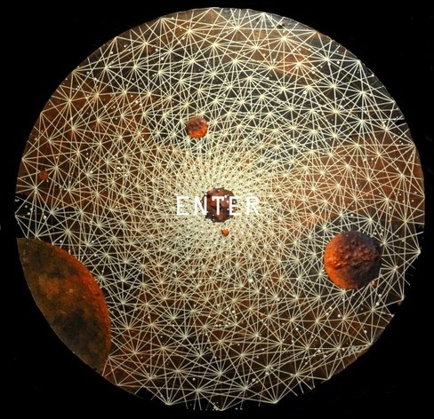
Sequence diagrams

Slide 64
UML: Sequence diagrams
Activation
:WatchUser
:Watch
:LCDDisplay
:Time
pressButton1()
blinkHours()
Object
Actor
pressButton1()
blinkMinutes()
pressButton2()
incrementMinutes()
refresh()
Message
pressButtons1And2()
commitNewTime()
stopBlinking()
Lifeline

Slide 65
Sequence diagrams
Used for modeling the requirements
Better description of use case scenarios
Allow description of additional actors
Used in the design
For a description of system interfaces
Passenger
TicketMachine
selectZone()
insertCoins()
pickupChange()
pickUpTicket()

Slide 66
Sequence diagrams (2)
Classes are presented in columns
Messages (actions) – with arrows
Participants – with a wide rectangles
The states – by dotted lines
Passenger
TicketMachine
selectZone()
insertCoins()
pickupChange()
pickUpTicket()

Slide 67
Messages
Passenger
ZoneButton
TarifSchedule
Display
selectZone()
lookupPrice(selection)
price
Dataflow
displayPrice(price)
Direction of the arrow determine the sender and recipient of the message
The horizontal dashed lines represent the flow of data

Slide 68
Iteration and conditions
Passenger
ChangeProcessor
CoinIdentifier
Display
CoinDrop
*
insertChange(coin)
lookupCoin(coin)
Iteration
price
displayPrice(owedAmount)
Condition
[owedAmount<0] returnChange(-owedAmount)
Iteration is noted with an * before the message
Conditions are marked with Boolean expression[ ]

Slide 69

StateChart diagrams

Slide 70
UML: StateChart diagrams
Event
Initial state
[button1&2Pressed]
[button2Pressed]
BlinkHours
IncrementHrs
Transition
[button1Pressed]
State
[button1&2Pressed]
[button2Pressed]
BlinkMinutes
IncrementMin.
[button1Pressed]
[button1&2Pressed]
[button2Pressed]
BlinkSeconds
IncrementSec.
Final state
StopBlinking

Slide 71
Activity diagrams
Show the flow of actions in the system
Special type StateChart diagrams, in which states are actions
Handle
Document
Archive
Incident
Incident
Incident

Slide 72
Activity diagrams: Condition modeling
Condition
[lowPriority]
Open
Allocate
Incident
Resources
[fire & highPriority]
[not fire & highPriority]
Notify
Fire Chief
Notify
Police Chief

Slide 73
Activity diagrams: modeling parallelism
Synchronization of action
Dividing the work of several threads
Splitting
Synchronization
Allocate
Resources
Open
Coordinate
Archive
Incident
Resources
Incident
Document
Incident

Slide 74
Other UML notations
UML provide and other types of diagrams (notations)
Implemental diagrams
Component diagrams
Deployment diagrams
Language for an object restriction
Define input and output conditions

Slide 75
Object-Oriented design and UML basics
?
?
?
?
?
Questions?
?
?
?
?
?
?

